Slide 1
Overview of Different Data Combination Methods [+Gaussian Simulation]
Ed Fomalont
JAO - NRAO

Slide 2
OUTLINE OF WORKSHOP
Comments from Monday morning Discussions
Compare methods and reliability
Monday afternoon (now)
This talk: General progress over decades. Simulations!
Next talk: Common combination practices
Tuesday: Several deconvolution methods
Wednesday and Thursday: Data combination examples
Lots of sub-group sessions
Friday: sub-group working over next month
Friday: sub-group proceedings.

Slide 3
Some History of Imaging Extended Objects
Högbom, J. A. 1974, A&AS, 15, 417: CLEAN ALGORITHM
1967-68: I was Post Doc In Leiden: Oort, vdHulst, vdLaan, Brouw, Hogbom
Cornwell, T.J., Holdaway, M.A. & UsonJ.M., 1993, Radio-interferometric imaging of very
large objects: implications for array design, A&A 271,697.
Analysis of TP and arrays with same antenna size. Excellent error analysis
Holdaway. M.A., 1999, Mosaicing with Interferometer Arrays, ASP Conference series 180, 401. NRAO summer school. Good introduction.
Greisen, E.W.,2002, Wide Field Imaging in Classic AIPS since 1970
Gluing each field together. Has some advantages.
Wright, M. 2012, ALMA Single Dish and Array Combination Workshop: Heterogeneous
Array Imaging:
http://w.astro.Berkeley.edu/~wright/ALMA/SingleDishandArrayCombinationWorkshopDec17-19.pdf
Rau, Naik, Braun, 2019, AJ 158,3,1: A joint Deconvolution …
Discussed in next talk, and throughout workshop.
ALMA imaging/deconvolution ‘relatively easy’ because of little large field
problems where sky curvature is important.

Slide 4
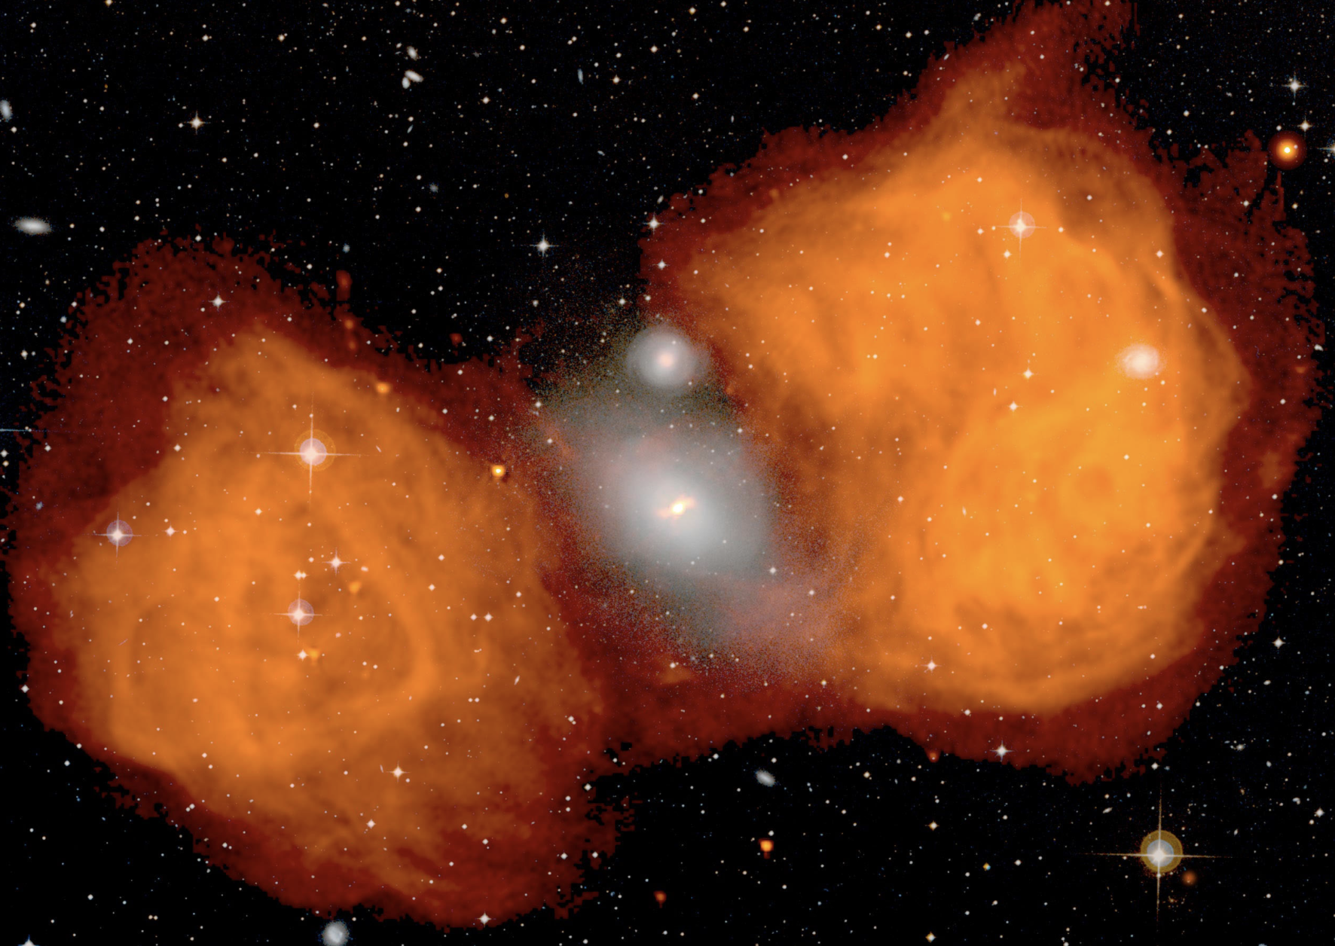
VLA image at 1.4 GHz of Fornax-A with 20” resolution
Three VLA pointing mosaic plus Parkes SD.
Each field imaged and then overlap combined,
Smooth to Parkes resolution and scale.
“A SIMPLE FEATHER”

Slide 5
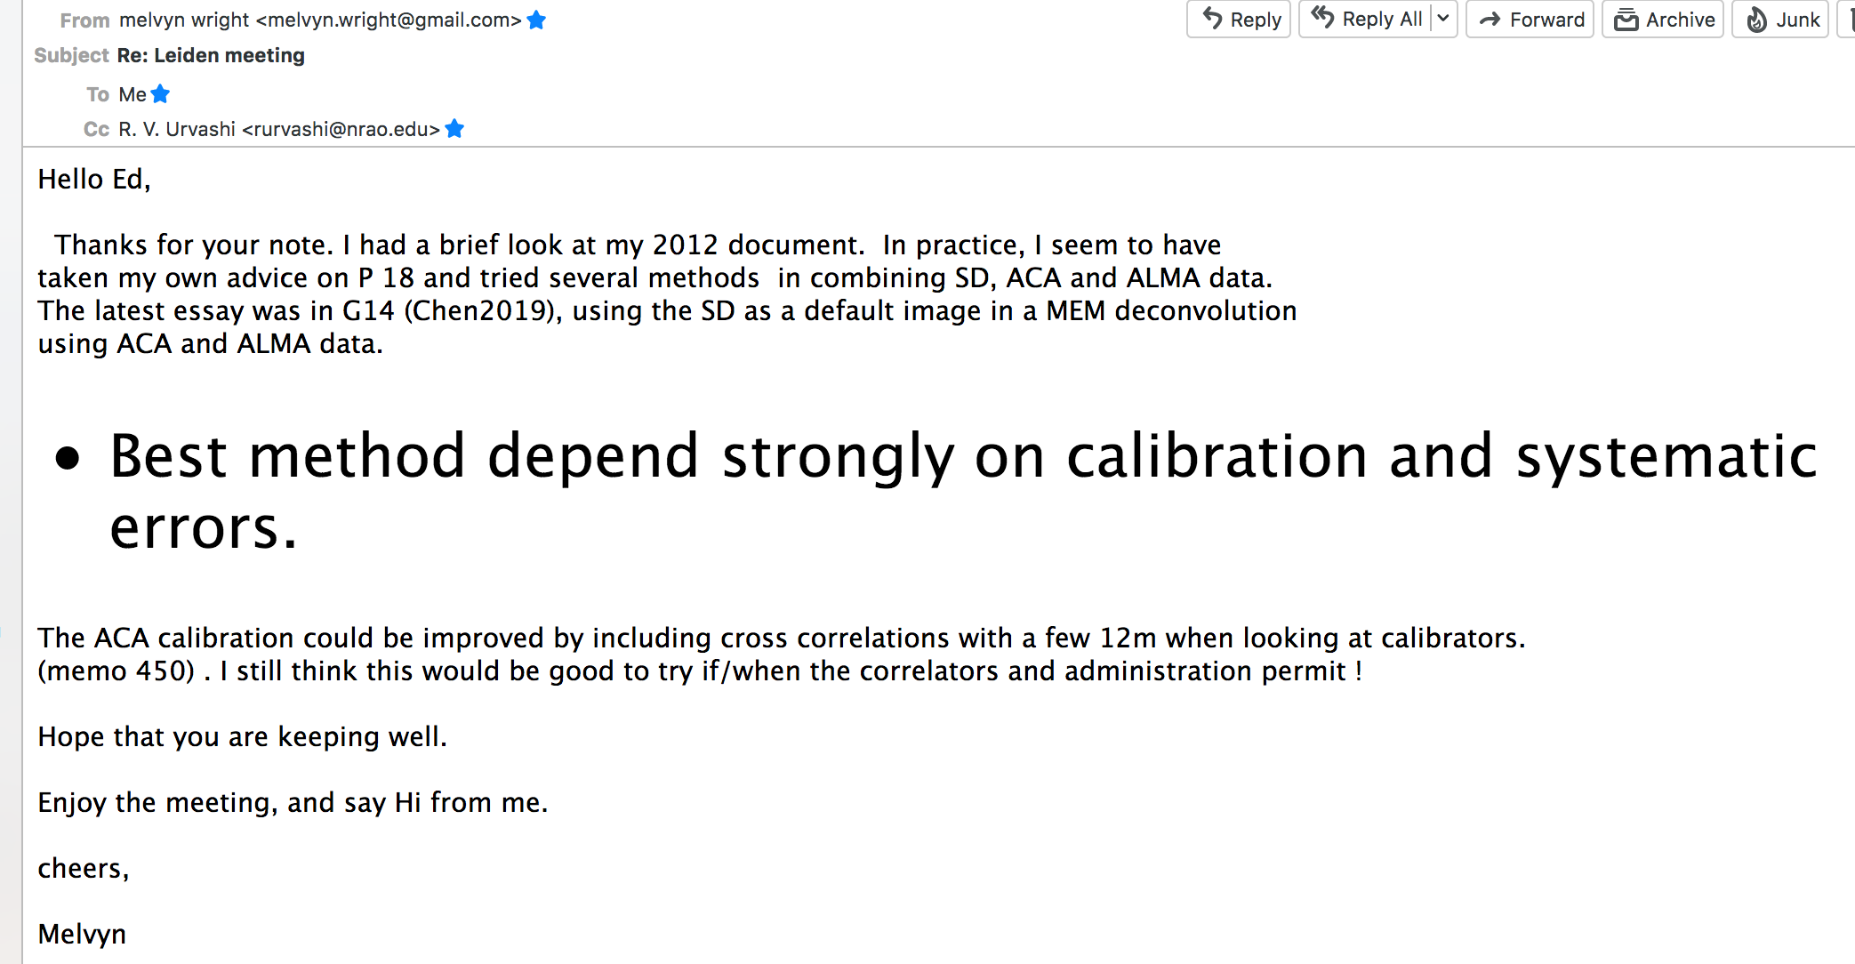

Slide 6
Goal: How to Combine ‘ALMA’ pieces
to obtain best quality images.
Pieces Available: ~10 configs of >=43 ALMA 12-m antennas
2 configs of up to 12 7-m antennas
ALMA TP image
+plus more TP’s and arrays.
Combine pieces to obtain best image.
Simple mode: One pointing of target fits in PB size
Number of ALMA configs depends on target angular properties:
min and max angular scale and ‘complexity’
TP (autocorrelation) of each antenna type (not a raster)
essentially measures uv=0 point – visibility at zero spacing
Collect all u-v data and deconvolve to make image.
OR: make several images corresponding to each config,
then feather them together.

Slide 7
This Workshop Goal: How to Combine ALMA
Mosaic Pieces with TP raster mode
Mosaic mode: More than one pointing position needed to cover
source extent.
Number of ALMA configs depends on target angular properties:
min and max angular scale and ‘complexity’
For example: mosaic of large region of point sources needs only
one 12-m ALMA configuration.
BUT: Many interesting sources have angular scale emission over
the mosaic area.
This area is imaged at lowest resolution using SD raster scans
from ANY antenna, but usually PM’s. Methods and errors not
discussed here.
How best to include this low resolution SD raster image data into
the other ALMA interferometric data/images? AND ERRORS

Slide 8
Real Data versus Simulations
Most of this workshop will deal with real ALMA
mosaic+tp observations of interesting fields.
Alternative: Take some mosaic experiments, remove the
observed data and replace with known sky model
Introduce TP image of this model data.
Test combination (feather vs tpvis vs other) results for
these combined data sets.
Can also introduce most synthesis errors to determine
their affects on the results.
What follows is a simple simulation result so far.

Slide 9
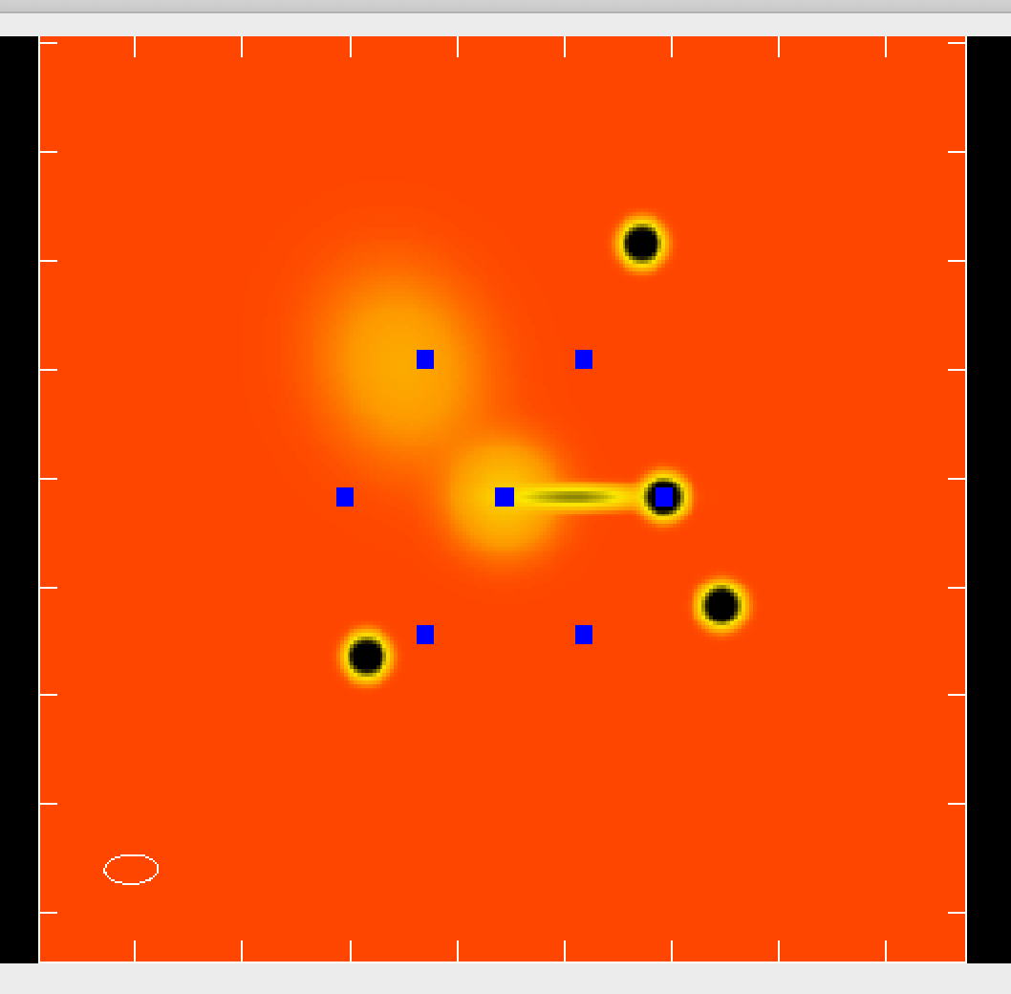
Simple Sky Model and Data Set for First Test
Data: 7-m array: Band 6 230 GHz: Considered only one spw chan
Two 45-min blocks. 7 pointing directions,
22” field separation, 27.3” FWHP TP beam size
Model:
Four 3”-round components
Two ~15” components,
One ‘jet’, 12”x2”
tick marks 20” separation
ACA pointing positions:
Blue Rectangles
Resolution 7.4”x4.0”
Used all CM antennas but CM05
Real ACA mosaic Data set Used.
Courtesy Hales CO observation.
Can use simulator.

Slide 10
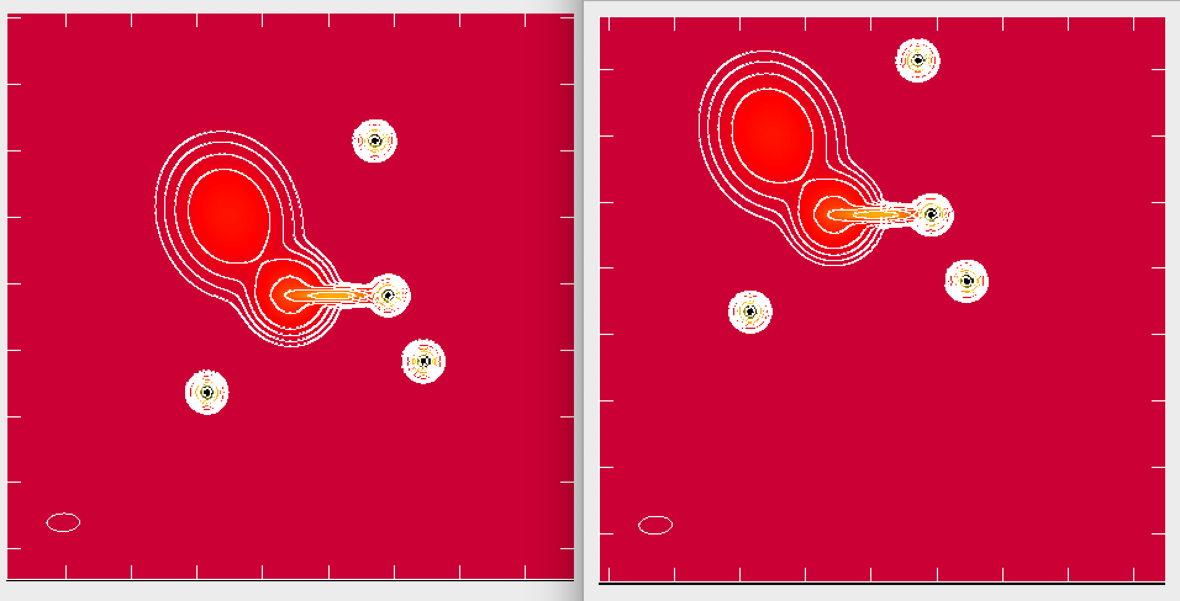
SKY MODEL
Sky emission seen with two ACA pointings
Left (central pointing); right (pointing to south-west)
Model contains four 3”-diameter sources, one jet and two extended objects. Resolution is 7.4x4.0” e/w. No PB cutoff

Slide 11
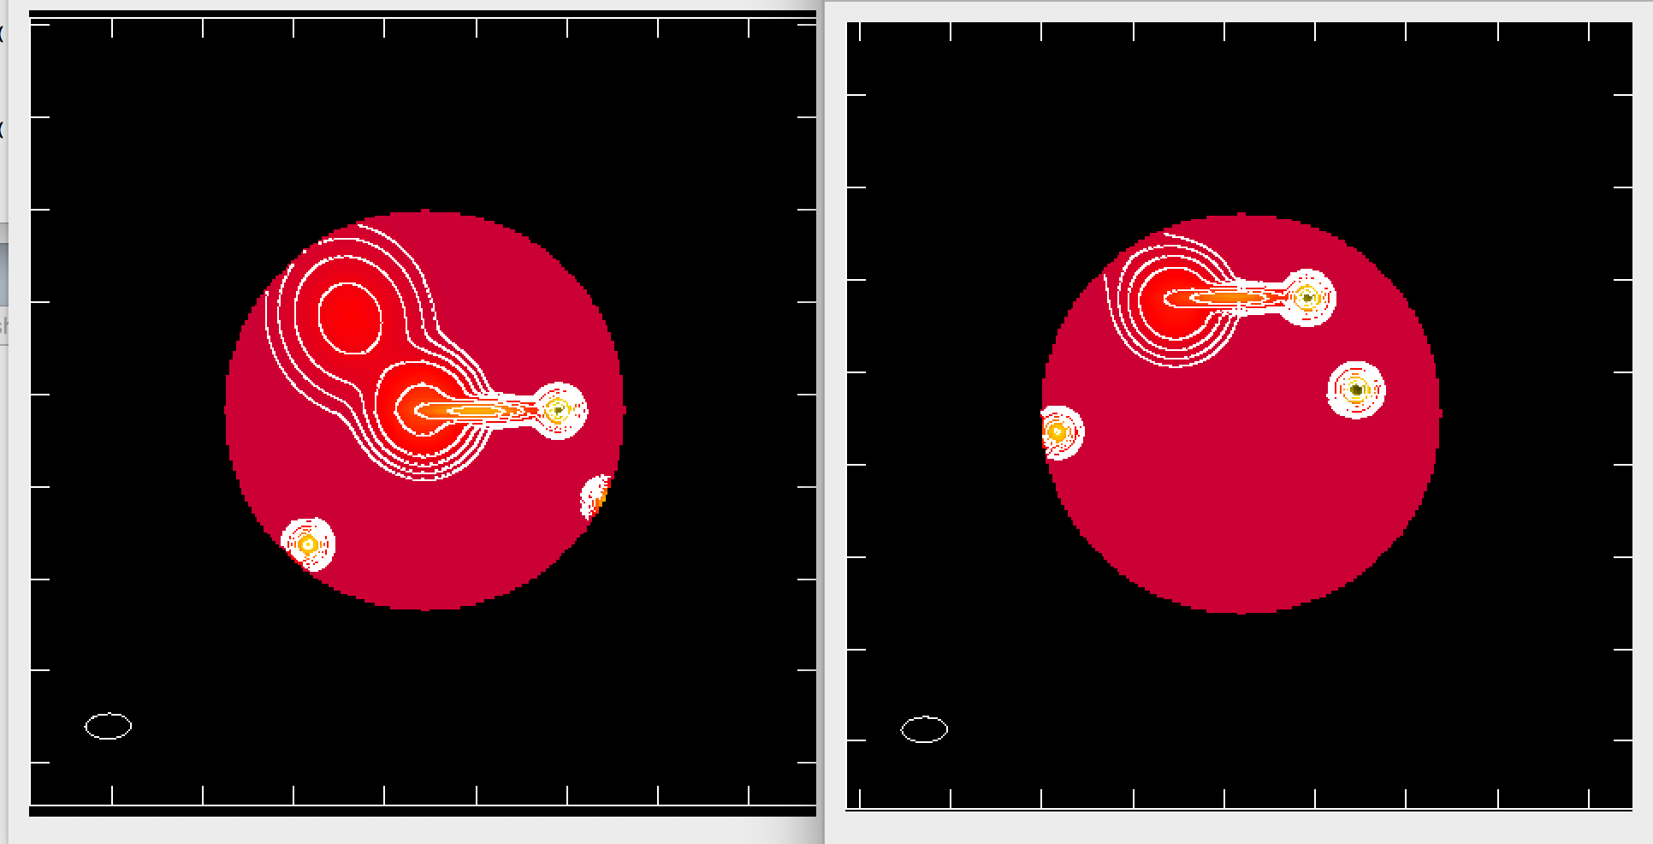
SKY MODEL with 7-m Primary Beam
Sky emission that includes 7-m antenna PB sens.
Left (central pointing); right (pointing to south-west)
7-m antenna sensitivity included, with 20% cutoff.
This defines the uv-data for each pointing via Fourier Transform

Slide 12
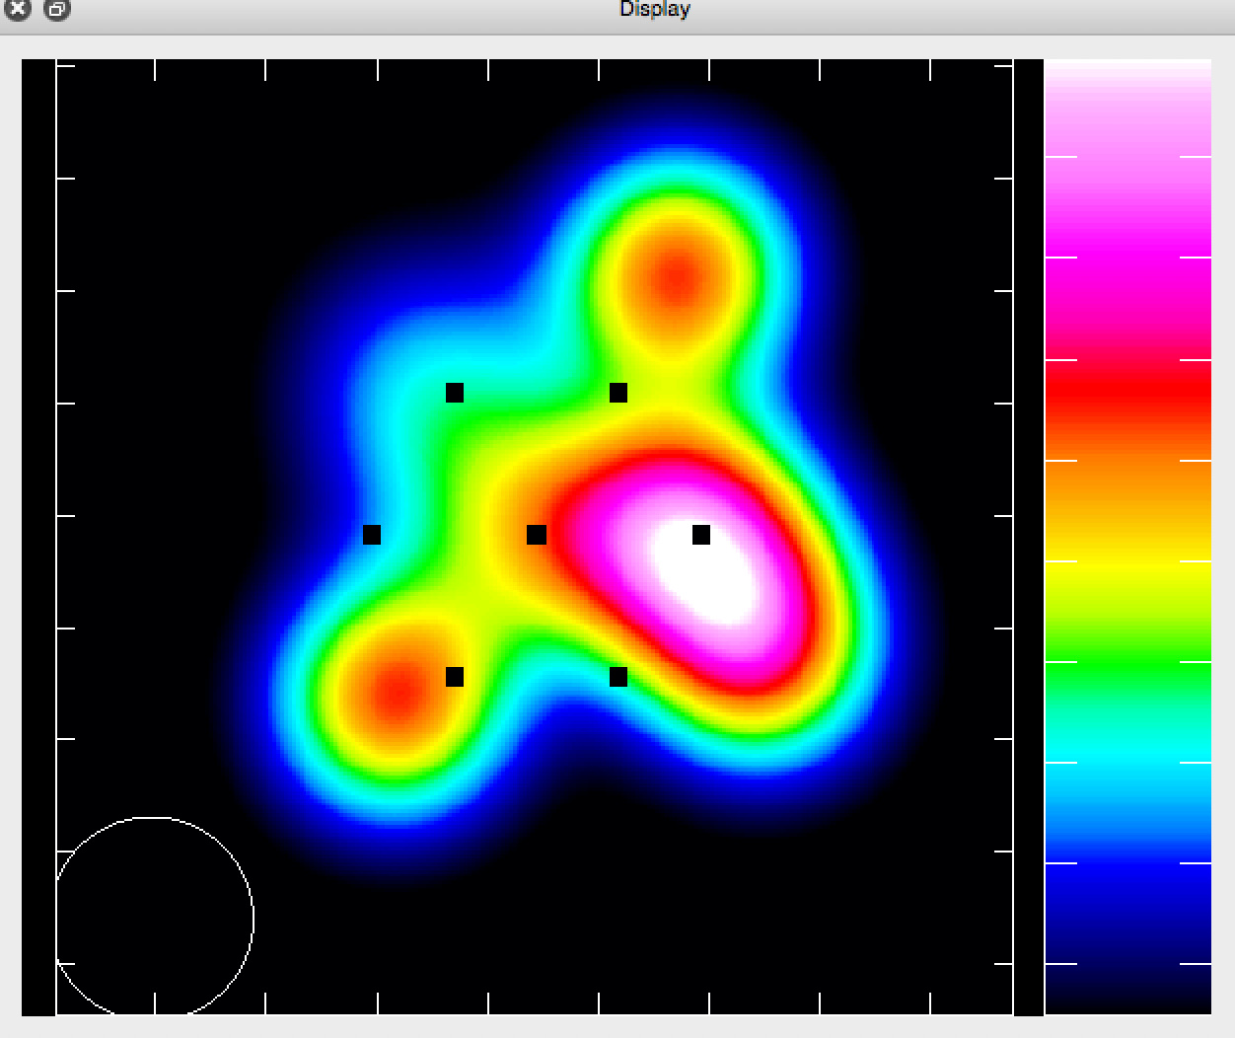
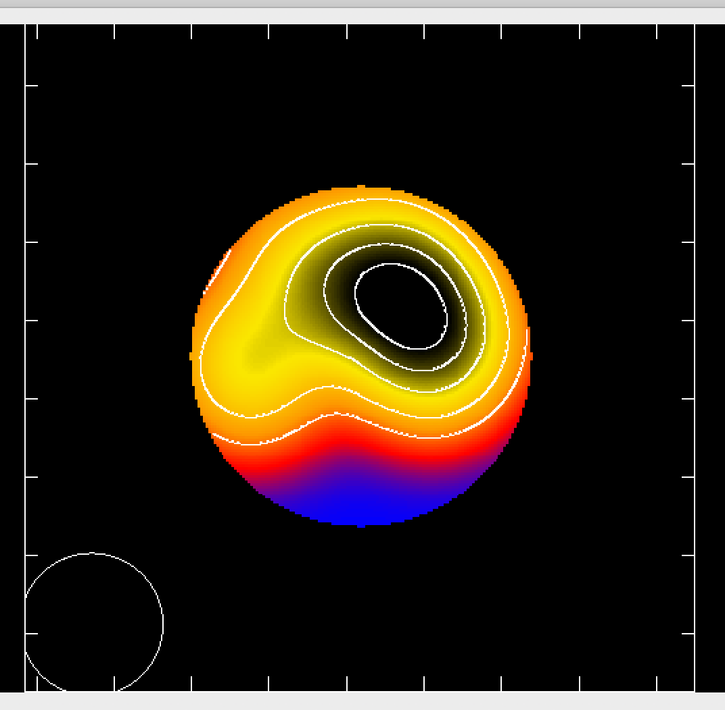
SINGLE DISH EMISSION
Sky emission with SD resolution of 27”
Sky emission around pointing 1
With PB correction. This is total
power with 27” res. in this pointing.

Slide 13
Methods of making Mosaic Image
--- Image/clean each pointing separately
Simple (AIPS), glue and combine (average) each pointing
--- Joint deconvolution of all fields in one step
Does appropriate averaging, better SNR
--- Add in TP image raster using feathering
OR
--- Make uv data for each pointing from TP image using FT.
--- Add this short spacing data (task tp2vis)
--- Join deconvolution of all fields in one step, now
includes TP data (short spacings: 0 to 7m spacing
SIMULATION RESULTS ARE:

Slide 14
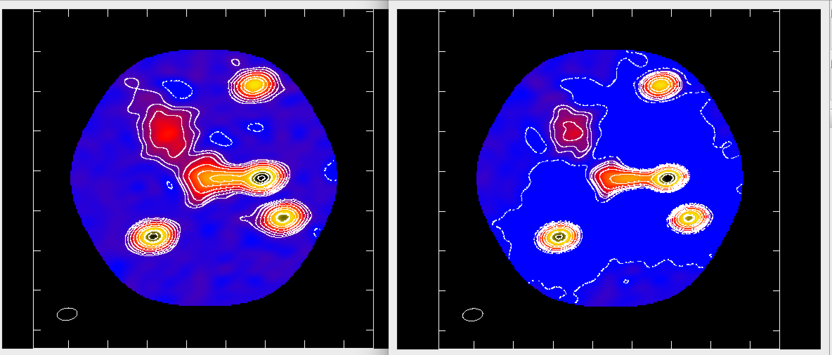
MOSAIC IMAGE + TP (uv or image)
TP uv + mosaic uv: joint deconvolution FEATHER: mosaic image + TP image
Contours: -1, 1, 2, 4, 8, 16, 25,50,70,90 percent of peak of TP uv
Field of view: down to 20% of mosaic sensitivity area

Slide 15
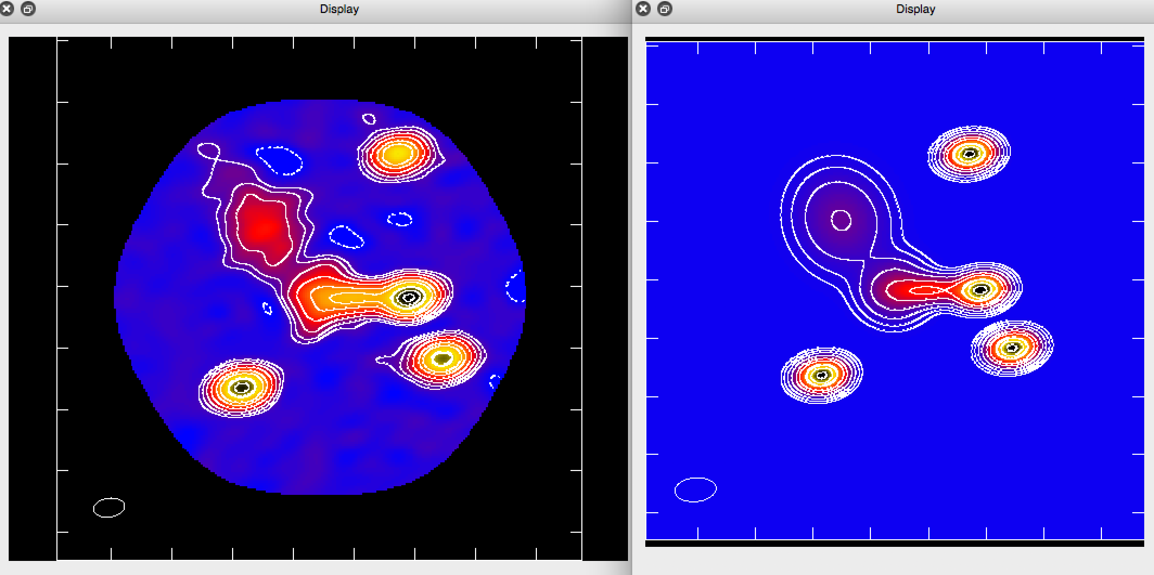
MOSAIC IMAGE (TPuv) VS SKY
TP uv + mosaic uv: joint deconvolution SKY + Mosaic PB + 7-m resolution
Contours: -1, 1, 2, 4, 8, 16, 25,50,70,90 percent of peak
Mosaic primary beam correction not include. Increases noise at edge.

Slide 16
USING SIMULATIONS THIS WEEK
Model defined by N Gaussians in SKY with ascii file
Given a CASA mosaic data set, use python script to
Fill each pointing field with appropriate uv data,
Either just Gaussians or on-top of existing data
Add appropriate thermal noise and calibration errors
Make appropriate TP raster images of pointed uv data
Primary beam uncertainties!
Compare various imaging techniques
Useful and how to extended
EFFECTS of Non-THERMAL ERRORS.

